Slide 1

Selected Topics in Computational Intelligence I
Session Enrichment 4
Unsupervised Neural Networks

Slide 2
Agenda
Learning Unsupervised Neural Networks
Self Organizing Map (SOM)
Hebbian Learning Rules
Implementation

Slide 3
What is SOM?
SOM is a neural networks without a teacher, i.e., unsupervised.
SOM perform learning based grouping of input data (clustering of input data).
Clustering is essentially the classifier of similar objects and separate the different objects.
.

Slide 4
What is SOM?
A SOM is a two layer neural network that accepts N-dimensional input patterns and maps them to a lattice of output neurons, which represents feature space.
These networks are based on competitive learning; the output neurons of the network compete among themselves to be activated or fired, with the result that only one output neuron, or one neuron per group, is on at any one time

Slide 5
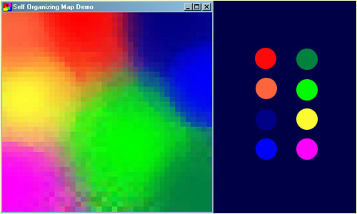
Why SOM ?
SOM able to learn to classify data without supervision. You may already be aware of supervised training techniques such as backpropagation where the training data consists of vector pairs - an input vector and a target vector.
Source: http://www.ai-junkie.com/ann/som/som1.html

Slide 6
Why SOM ? (con’t)
In a self-organizing map, the neurons are placed at the nodes of a lattice that is usually one or two dimensional.
As a neural model, the SOM provides a bridge between two levels of adaptation:
Adaptation rules formulated at the microscopic level of a single neuron;
Formation of experientially better and physically accessible patterns of feature selectivity at the microscopic level of neural layers.

Slide 7
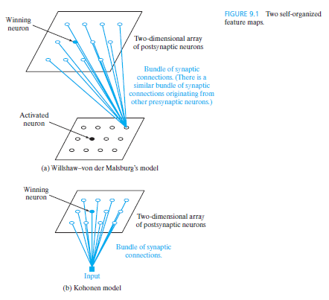
Layout of SOM
Figure shows the layout of the two models.
In both cases, the output neurons are arranged in a two-dimensional lattice.
The models differ from each other in the manner in which the input pattern are specified.

Slide 8
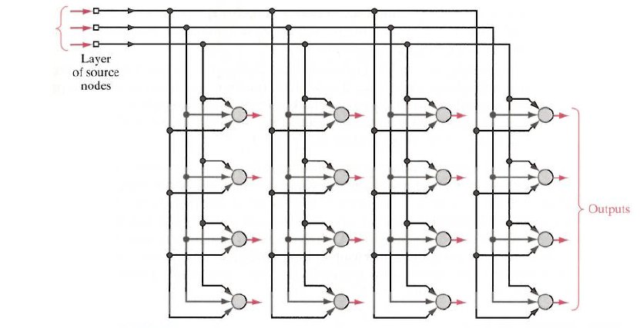
Layout of SOM
The principal goal of the self-organizing map (SOM) is to transform an incoming signal pattern of arbitrary dimension into a one- or two-dimensional discrete map
The algorithm performs this transformation adaptively in a topologically ordered fashion.
Input
vector
Figure 11.1 Two-dimensional lattice of neurons, illustrated for a three-dimensional input and four-by-four dimensional output (all shown in red).
Notes:
Sources:
Haykin, S. (2009). Neural Networks and Learning Machines, 3rd ed. Pearson. ISBN: 978-0-13-129376-2

Slide 9
Layout of SOM
Once the network has been properly initialized, there are three essential processes involved in the formation of the self-organizing map:
Competition. For each input pattern, the neuron in the network compute their respective values of a discriminant function. This discriminant function provides the basis for competition among the neurons. The particular neuron with the largest value of discriminant function is declared winner of the competition.
Cooperation. The winning neuron determines the spatial location of a topological neighborhood of excited neurons, thereby providing the basis for cooperation among such neighboring neurons.
Synaptic Adaptation. This last mechanism enables the excited neurons to increase their individual values of the discriminant function in relation to the input pattern through suitable adjustments applied to their synaptic weights. The adjustments made are such that the response of the winning neuron to the subsequent application of a similar input pattern is enhanced.

Slide 10
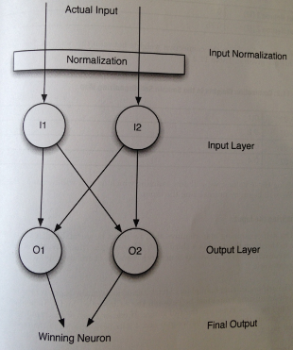
example
The SOM only contains an input neuron layer and an output neuron layer.
Input neuron 1 (i1) =0.5
Input neuron 2 (i2) =0.75
Weight i1->01 =0.1
Weight i2->01 = 0.2
Weight i1->02=0.3
Weight i2->02=0.4

Slide 11
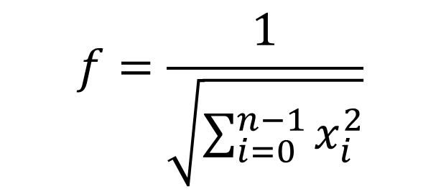
Normalization
Input to SOM must be between -1 and 1
Input for SOM is generally normalized using multiplicative normalization (simpler) and x-azis normalization
Multiplicative Normalization
1.0/Math.sqrt ((0.5*0.5) + (0.75*0.75)) produces Normalization factor of 1.1094

Slide 12
Calculating SOM output
[0.5 0.75]*[0.1 0.2] = (0.5*0.75) + (0.1 * 0.2)=0.395
Multiply dot product of 0.395 by the normalization factor of 1.1094.
Output 0.438213 must be mapped to a bipolar number
In the bipolar systems, the binary zero maps to -1 and the binary one remains a 1.
For the output of 0.438213, the result is a final output of -0.123574
The value -0.123574 is the output of the first neuron, this value will be compared with the outputs of the other neuron.

Slide 13
Choosing the winner
The same normalization factor is used to calculate the second output neuron.
The first neuron -0.123574 and the second neuron
-0.9068104.
To choose the winning neuron, we select the neuron that produces the largest output value
The winning neuron is the second output neuron
-0.9068104

Slide 14
How SOM Learns
The training process of the SOM is competitive. For each training set, one neuron will “WIN”. This winning neuron will have its weight adjusted so that it will react even more strongly to the input the next time it sees it.
As different neurons win for different patterns, their ability to recognize that particular pattern will increase.

Slide 15
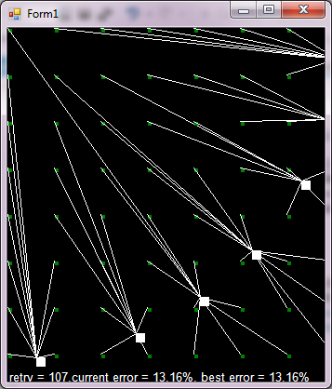
Result
The program contains two input neurons and seven output neurons.

Slide 16
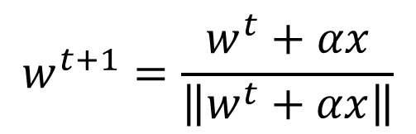
How SOM Learns
The learning rate is used to adjust weights of the neuron and is typically 0.4-0.5 an positive number
Adjusting weights(additive):
x is the training vector and w^{t} is the weight of the winning neuron.

Slide 17
Hebbian Learning Rule
The Hebbian learning rule, named after the neuropsychologist Hebb, is the oldest and simplest learning rule.
With Hebbian learning, weight values are adjusted based on the correlation of neuron activation values.

Slide 18
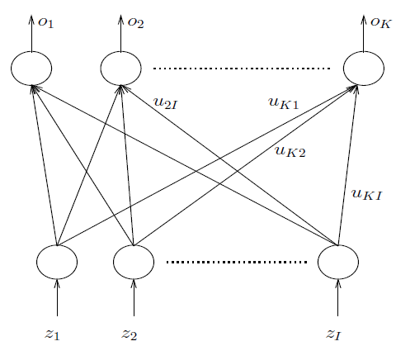
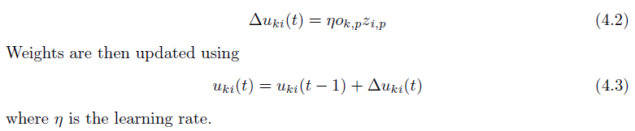
Hebbian Learning Rule
change in weight at time step t is given as

Slide 19
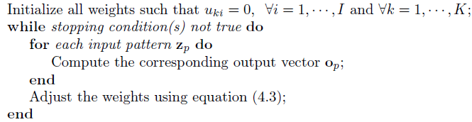
algorithm

Slide 20
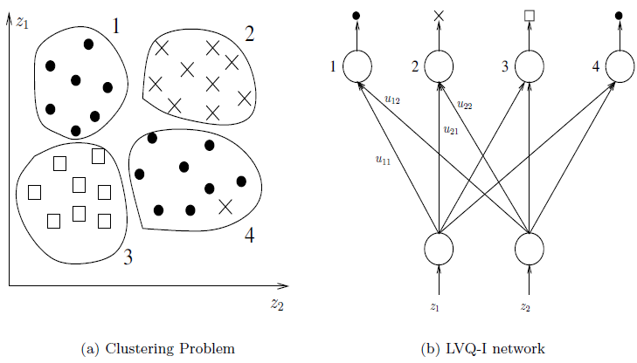
Learning Vector Quantizer-I
One of the most frequently used unsupervised clustering algorithms is the learning vector quantizer (LVQ) developed by Kohonen.

Slide 21
Summary
SOM is a neural networks without a teacher, i.e., unsupervised.
SOM perform learning based grouping of input data (clustering of input data).
There are two basic feature-mapping models: Willshaw-von der Malsburg’s model and Kohonen model

Slide 22
Example SOM
Optical Character Recognition (OCR) is a good application for the Self Organizing Map (SOM). To recognize any of the 26 Latin characters we use 26 output neurons. These are the groups that the input letters will be broken into.
The input neurons are a grid. For example, if the character resolutions were 5x7, there would be 35 input neurons. The demo program allows the user to draw the characters at a higher resolution than 5x7.

Slide 23
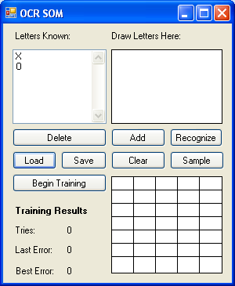
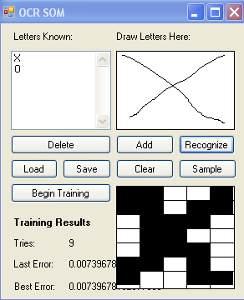
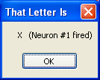
Implementation
Source: Jeff Heaton (2012), Introduction to Neural Networks for C#, Heaton Publisher.

Slide 24
Summary
The essence of Kohonen’s SOM algorithm is that it substitutes a simple geometric computation for the more detailed properties of the Hebb-like rule and lateral interactions.
There are three basic steps involved in the application of the algorithm after initialization: sampling, similarity matching, and updating.

Slide 25
References
Adries P. Engelbrect. (2007), Computational Intelligence An Introduction. 2nd ed. John Wiley & Sons. USA.
Jeff Heaton (2012), Introduction to Neural Networks for C#, Heaton Publisher.
http://www.ai-junkie.com/ann/som/som1.html
Jeff Heaton (2012), Introduction to Neural Networks for C#, Heaton Publisher.

Slide 26
Thank You

